Slide 1
Text Document Clustering
Using Spectral Clustering & Particle Swarm Optimization

Slide 2
Table of Contents
What is Text Document Clustering?
Motivation for Document Clustering
Existing algorithms in Literature
Steps in Document Clustering
SCPSO algorithms
Our Ideas & Contribution
Implementation details
Language & Frameworks used for the task
Experiments & Results
Conclusion
Future Direction

Slide 3
What is Text Document Clustering?
Document clustering is a gathering of textual content documents into groups or clusters
Aim is to cluster the documents, which are internally logical but considerably different from each other
Used in Information Retrieval, Information Extraction and Document Organization
Google’s search engine is probably the best and most widely known example of Text Document Clustering

Slide 4
Motivation of Document Clustering
To create structure of text data
The number of available articles is large
A large number of articles are added each day
To link similar documents and remove duplicate documents
The recommendations has to be generated and updated in real time
Articles corresponding to same news are added from different sources
Automatically group related document based on their content
By clustering the articles we could reduce our domain of search for recommendations which leads in improved time efficiency to a great extent

Slide 5
Existing Algorithms in Literature
Topic models
Spectral Clustering
Genetic Algorithms
Semi-Supervised Clustering
Meta Heuristic Optimization
Particle Swarm Optimization(PSO)
K-means clustering(gives local optimum)
Swarm Intelligence(gives global optimum)
Combination of Nystrom Spectral Clustering & Genetic Algorithm

Slide 6
Steps in Document Clustering
Document preprocessing
Tokenization
Stemming
Lemmatization
Document Representation
Word Count vector
TF-IDF vector
Maximum Likelihood Estimation
Bernoulli distribution
Gaussian distribution
Poisson distribution

Slide 7
Similarity measures
Cosine Similarity
Euclidean distance
Spectral Clustering Algorithm
Similarity graph
Graph Laplacian Matrix
Un Normalized (D - W)
Normalized (D^−1/2*(D-W)* D^−1/2)
Normalized with Random Walks (D^−1/2*(D-W))
Eigen Vectors
Particle Swarm Optimization

Slide 8
Spectral Clustering with PSO(SCPSO)
It combines Spectral Clustering & Particle Swarm Optimization
Improve the accuracy of Text Document Clustering
Reduces global Convergence, computational complexity
Can handle large number of objective function
More flexible
Can find clusters of arbitrary shapes, under realistic separations
Able to cluster points which are not necessarily vectors

Slide 9
Spectral Clustering with PSO(SCPSO)
The SCPSO is a spectral based clustering method which uses the particle swarm optimization algorithm.
It has the following three important steps:
Similarity graph generation
Particle swarm optimization
Clustering methods
Dataset that we have used is Reuters which contains text documents of different categories.

Slide 10
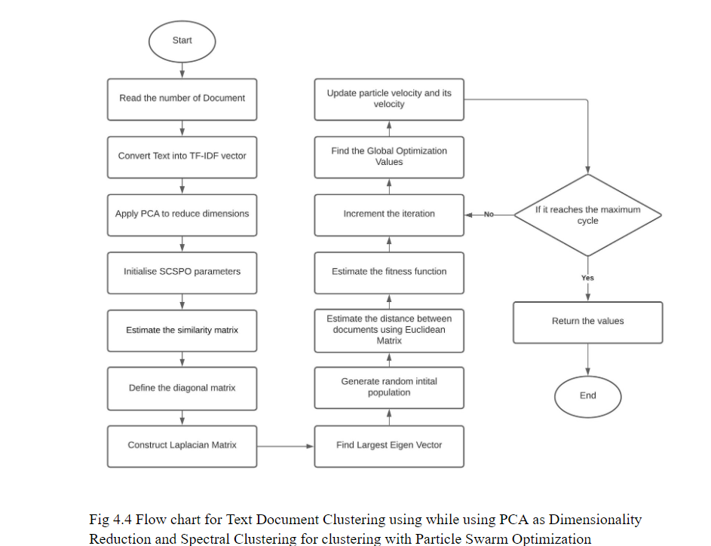
Flow of Clustering is as follows:

Slide 11
Our Ideas and Contribution
We first implemented the SCPSO algorithms mentioned in paper and tried to achieve the accuracy as that of paper. In paper there is no mention of PCA so we tried the following:
Computed PCA of TF-IDF feature vector for doing Dimensionality Reduction
Tried PCA for values such as 2, 100, 200, 250, 280, 350, 500, 750, 900
Best score was found when number of features = 270
Tried SCPSO algorithm on Affinity matrix with Gaussian Kernel
Tried SCPSO algorithm on Affinity matrix with Euclidean Distance

Slide 12
For making visualisation possible(as there are 1000 features), we did PCA with 2 features to visualise the word Embeddings in 2D space
We have used Adjusted Rand Index(ARI) to check how efficient results we have obtained
Implemented bar plots for visualising the ARI of various clustering methods we tried
Created Word Embedding of the input Text Document for visualising the text of Document in 2D space using Gensim library

Slide 13
Implementation Details
Experimental Setup
2.00 GHz Intel CPU with 2GB of RAM & running on windows 10
Dataset
Reuters 21578
Algorithms
SCPSO with K-means
Idea incorporated
Applied PCA to TF-IDF feature vector
Applied PCA on Affinity Matrix with Euclidean Distance & Gaussian Kernel
Performance measure
Adjusted rand Index(ARI)

Slide 14
We have used Reuters dataset, used NLTK library for importing stopwords, converted text to lowercase containing only letters. Created a vocabulary of words that will be used. We created TF-IDF vectors from the text. We have then done the visualisation of the text as embeddings, word embeddings give us the idea of words which have similar meanings or representation. Then we have used the Spectral Clustering(SC) with Particle Swarm Optimization(PSO) on the cleaned data. We have fit the data in the model and then predicted the data. Then we have used Adjusted Rand Index(ARI) which is giving us the measure of how well the clusters have been formed.

Slide 15
Then we have tried out to apply new ideas and make changes. We have used Principal Component Analysis(PCA) on the dataset which will reduce the number of features while the information of the data is retained and the training becomes more meaningful and easier. The first idea is to use Euclidean Distance on the affinity matrix for the Spectral Clustering. The second idea is to Gaussian Kernel on the affinity matrix for the Spectral Clustering. For each of these ideas we get Adjusted Rand Index(ARI). At last we compare the score for all the models that we have obtained.

Slide 16
Language & Frameworks used
Python is used as scripting language
Jupyter Lab is the editor used for writing the code & visualising the graph
Following libraries are used:
NLTK - for Natural Language Processing
Numpy - for mathematical operation
Pandas - for dataframe operation
Matplotlib - for plotting & drawing graphs
Sklearn - for SCPSO, PCA & other ML algorithms
Gensim - for Visualising Word Embeddings in 2D space

Slide 17
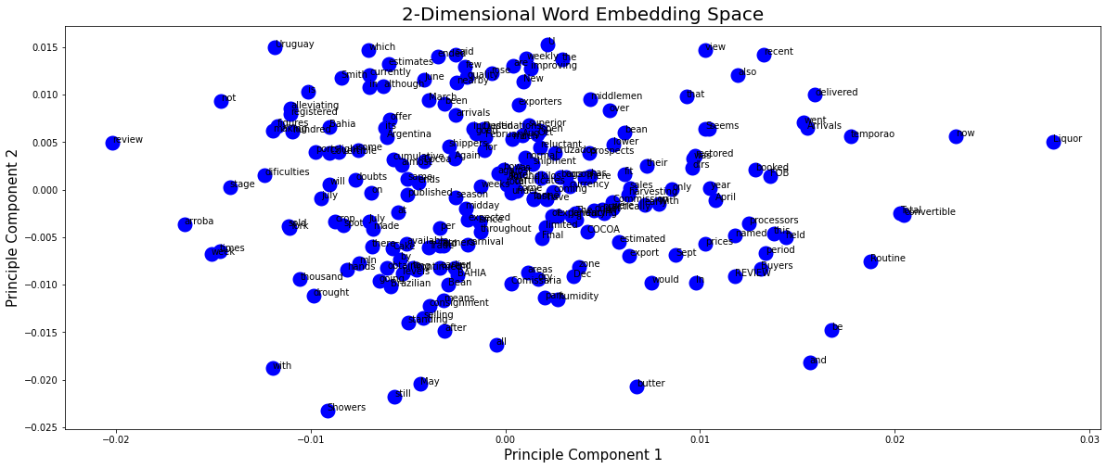
Experiments & Results

Slide 18
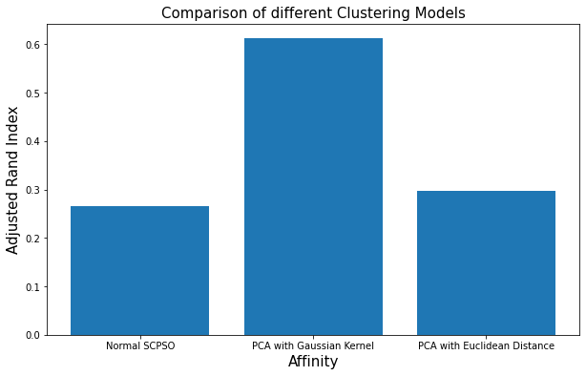

Slide 19
Conclusion
SCPSO get a solution for graph partition hence useful for creating clusters.
Document Clustering problem is an open issue for researchers in the area of text mining and information retrieval.
Spectral Clustering algorithm has better results when compared to the existing clustering methods such as K-means.
Spectral Clustering with Particle Swarm Optimization (SCPSO) improves the document clustering accuracy and it leads the result on the way to an optimal solution.

Slide 20
The problems that can be solved by K-means can also be solved by Spectral Clustering but not the other way around.
We observed that applying PCA reduces the number of dimensions in the data while retaining most of the information, hence training has become more meaningful.
On comparing all the models that have been built and tested, the model that has PCA applied on the data using Gaussian Kernel is giving the best result overall.

Slide 21
Future Direction
The method can be implemented on a multi-core CPU.
Hybrid clustering can be applied in order to increase the robustness of the algorithms.
Instead of PCA, other Dimensionality Reduction algorithms such LDA can be applied.
To attain the accomplished results of text document clustering, distinct intentions may be introduced.
This work will be motivated by the enhancements that can be applied to the Spectral & Optimization algorithms.

Slide 22
Thank You !!!

